Slide 1


A guide for new Reception pupils

Slide 2
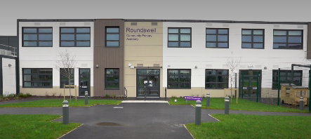
Welcome to Roundswell Community Primary Academy

Slide 3
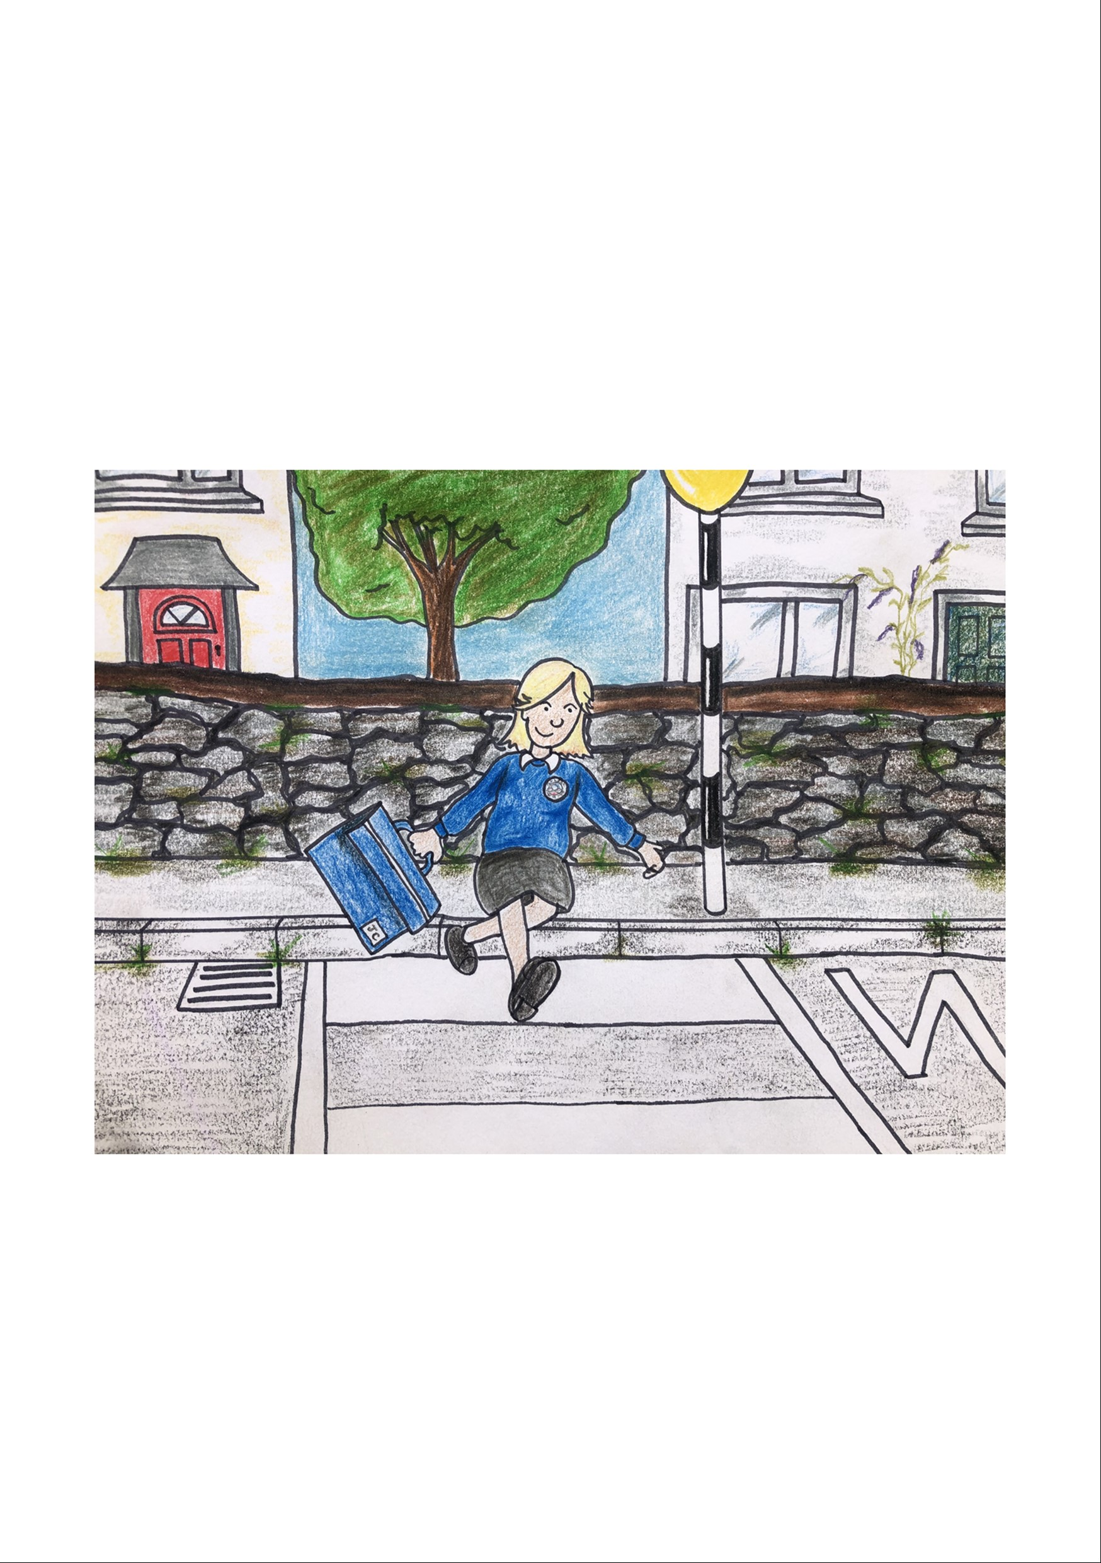
Talk to your adult at home to decide how you will travel to school. You might walk, cycle, scoot or drive in a car.
Please remember to stay safe and cross the roads safely.

Slide 4
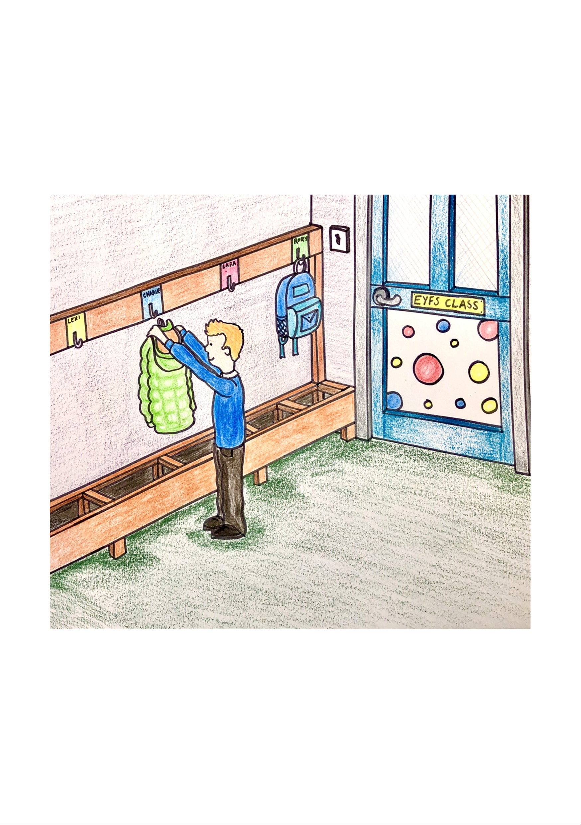
When you come into school you walk in your classroom and put your coat, healthy snack and book bag in your own locker.
Place your water bottle on the shelf provided.

Slide 5
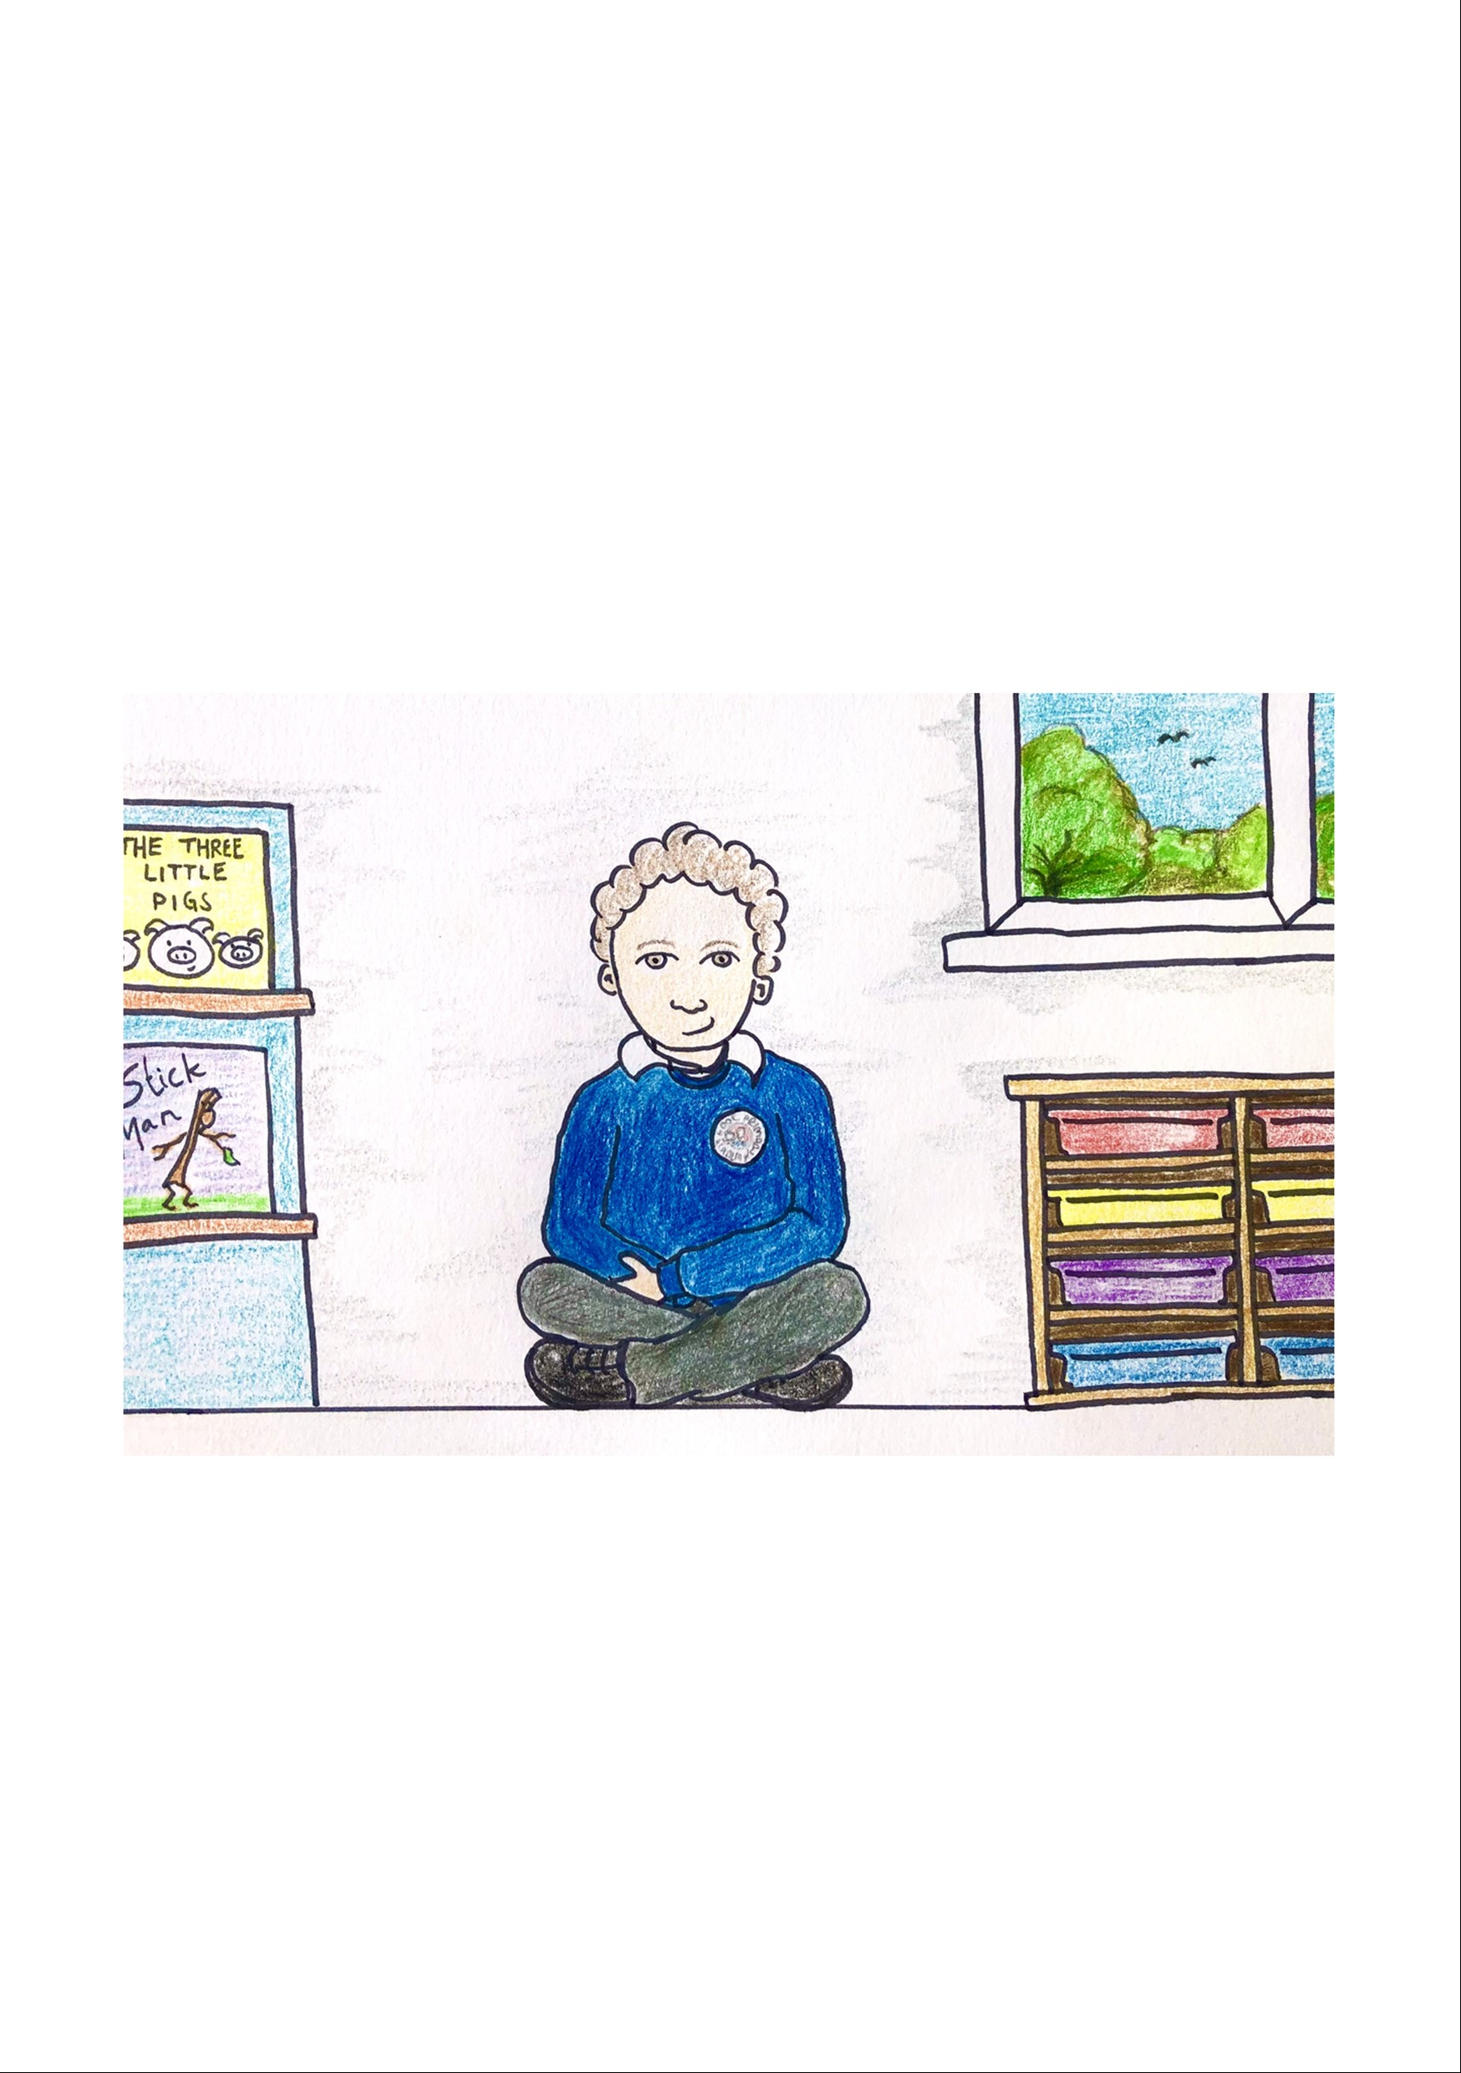
When you sit on the carpet, please sit with your legs crossed and keep your hands in your lap. You will face your teacher or the interactive whiteboard.
If you want to share your ideas, please put up your thumb and wait for the adult to ask you to speak.

Slide 6

At playtime and lunchtime you can play outside on the large playground. We eat our lunch in the hall with our friends. Some children have a school dinner and some children bring a packed lunch from home.

Slide 7
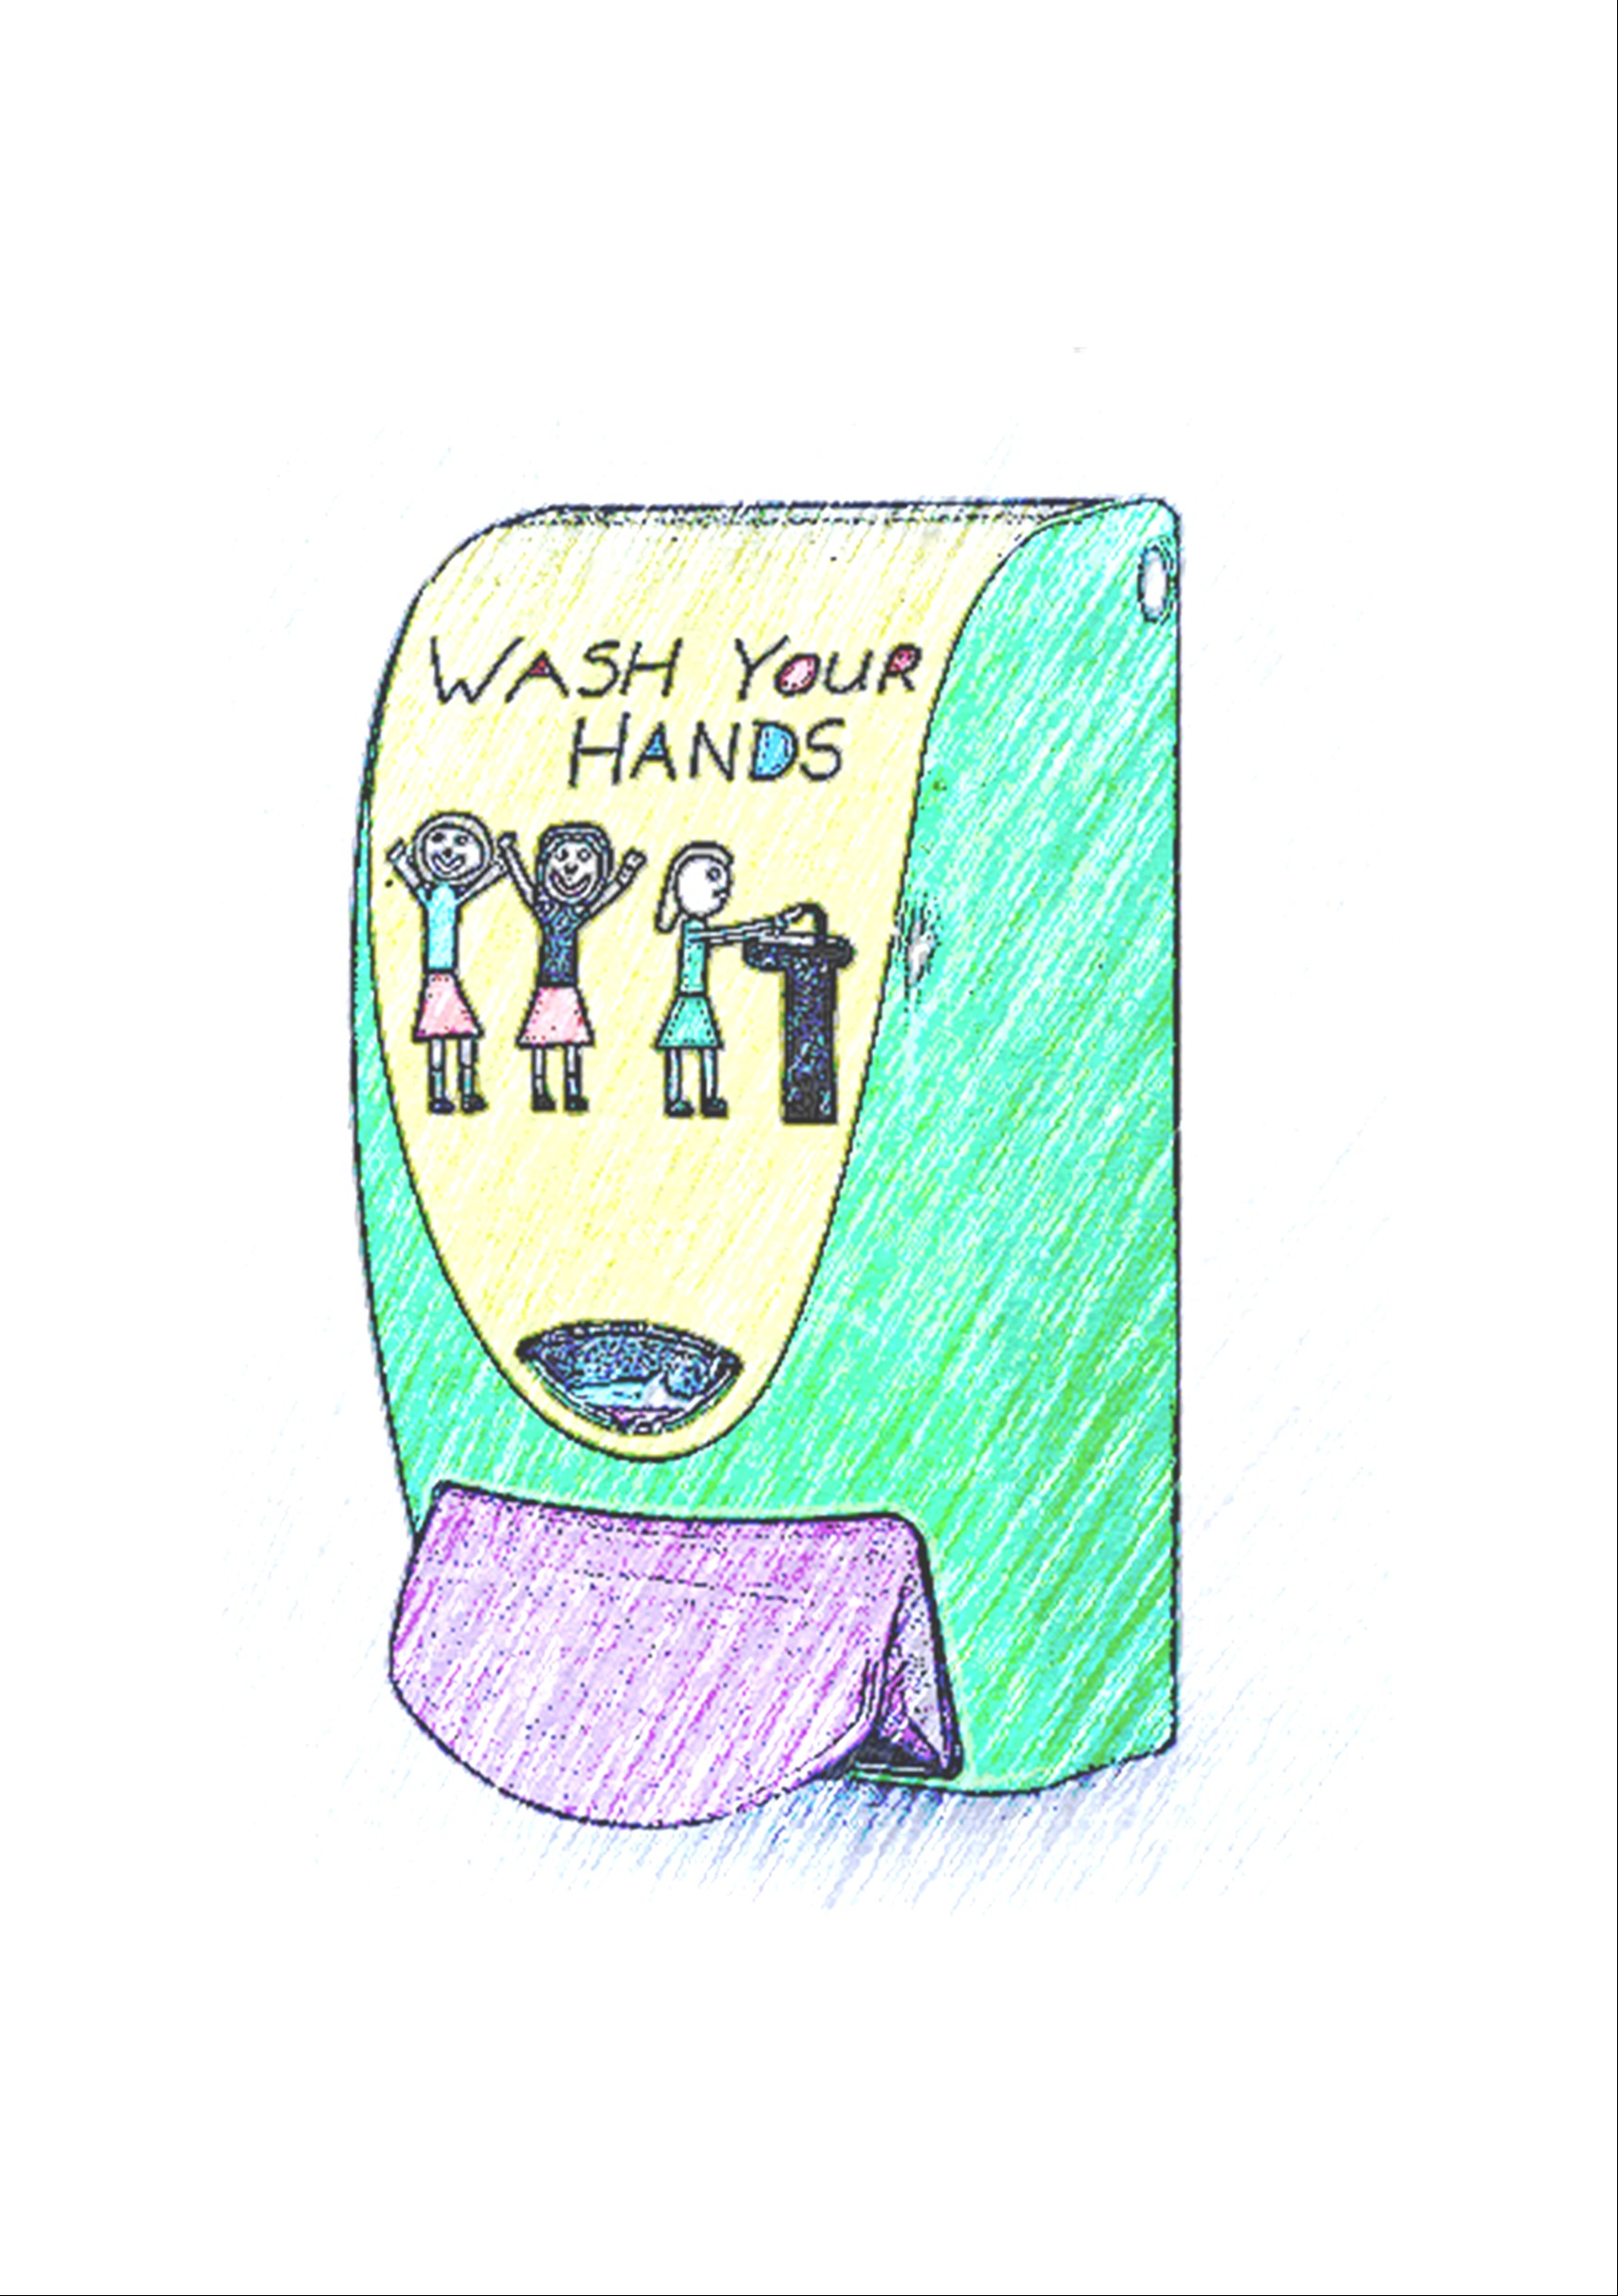
In school you will be asked to wash your hands to keep them clean.
The bathroom is near our classroom. We have three toilets just for our class!

Slide 8
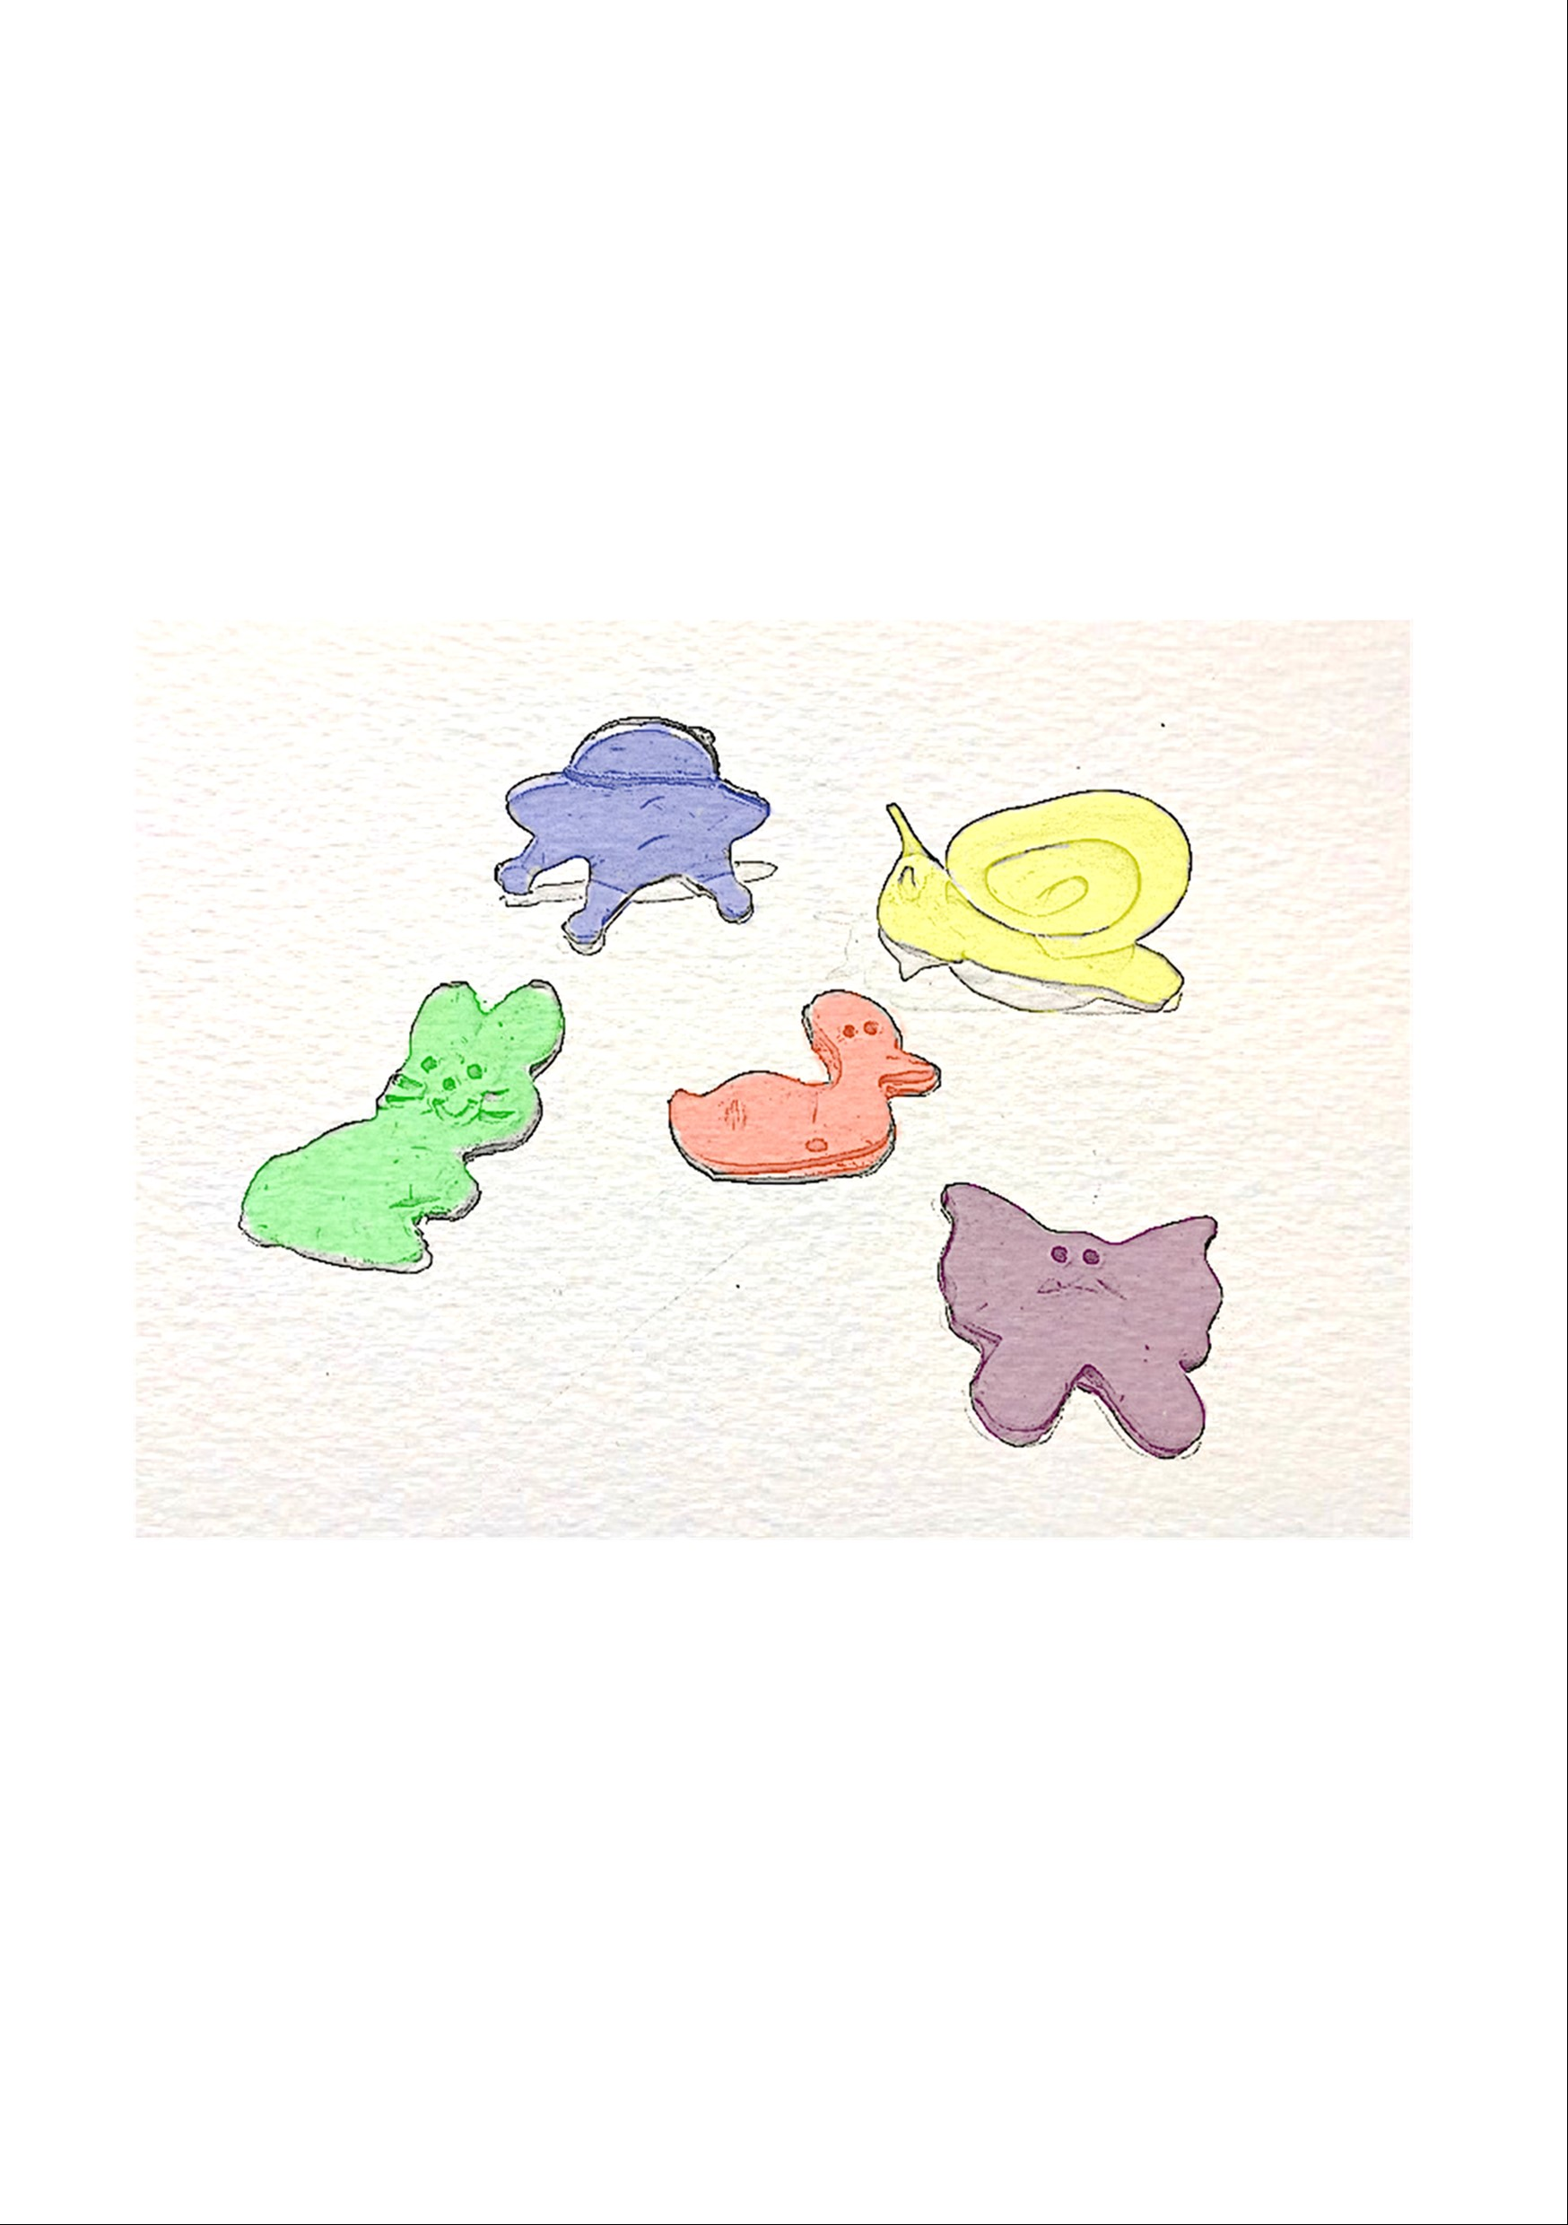
We have lots of fun in school and take part in lots of different activities.
We hope you are looking forward to learning lots and making new friends at Roundswell Community Primary Academy.

